Slide 1
Plants
*organisms that have cells with cell wall made of cellulose
*some parts of plant are green – pigment called chlorophyll which absorbs light from sunlight, plant use this energy to make glucose from CO2 and water , the process called photosynthesis
*plant include small organisms such as mosses as well as ferns and flowering plants

Slide 2
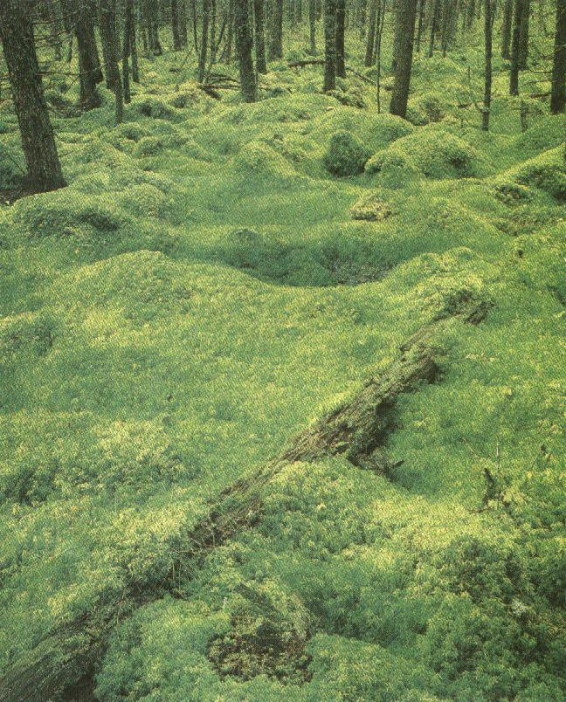
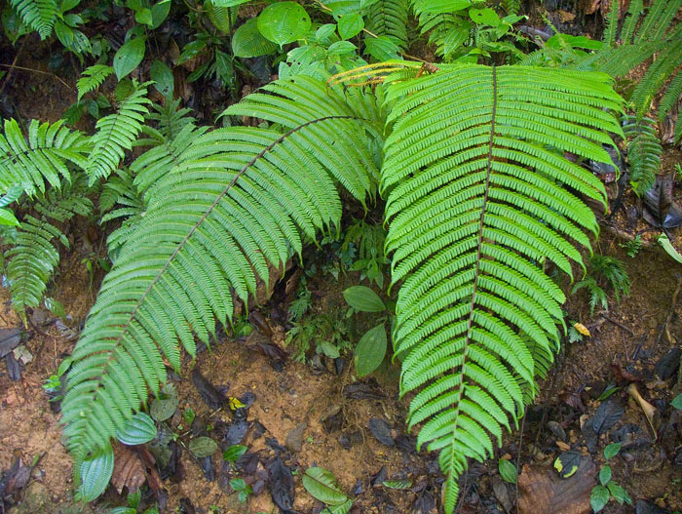
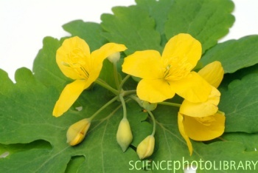
mosses ferns flowering
Angiosperms

Slide 3
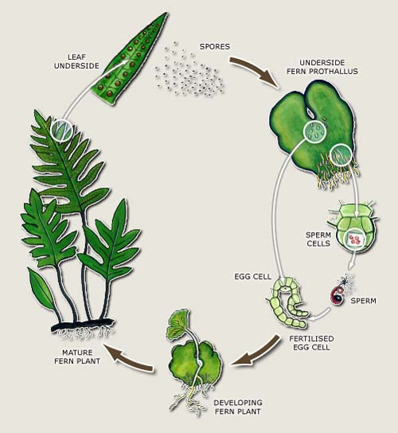
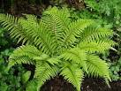
Ferns
Have leaves called fronds .
They do not produce flowers
Reproduce by spores underside of the fronds
Stem, roots and leaves

Slide 4
Phylum flowering plants could be trees or herbs
General characters
1- have root , shoot and leave
2- have xylem and phloem
3-reproduce sexually by producing seeds from flowers
4- seeds produce inside ovary ,in the flower
5- could be monocotyledonous or dicotyledonous

Slide 5
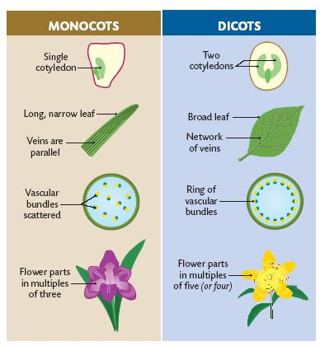
Phylum flowering plants
corn
pea
seed
Strap shape

Slide 6
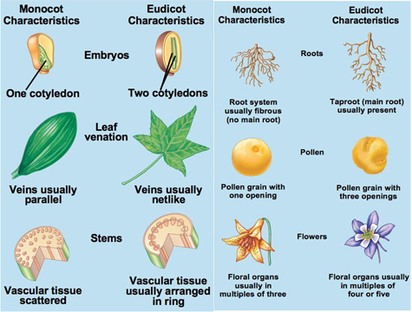
Phylum flowering plants

